Slide 1
Topic : Restaurant management system
Team Members :
Kushal Upadhyay
Dhruv Dave
Jeel Shah
Yugant Trivedi

Slide 2
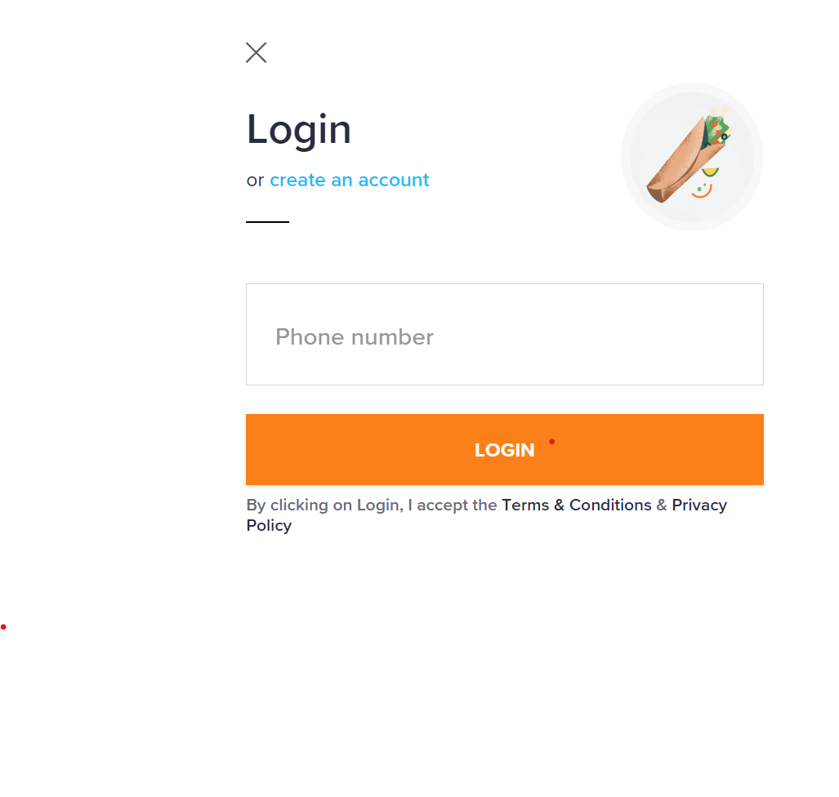
Login Page:

Slide 3
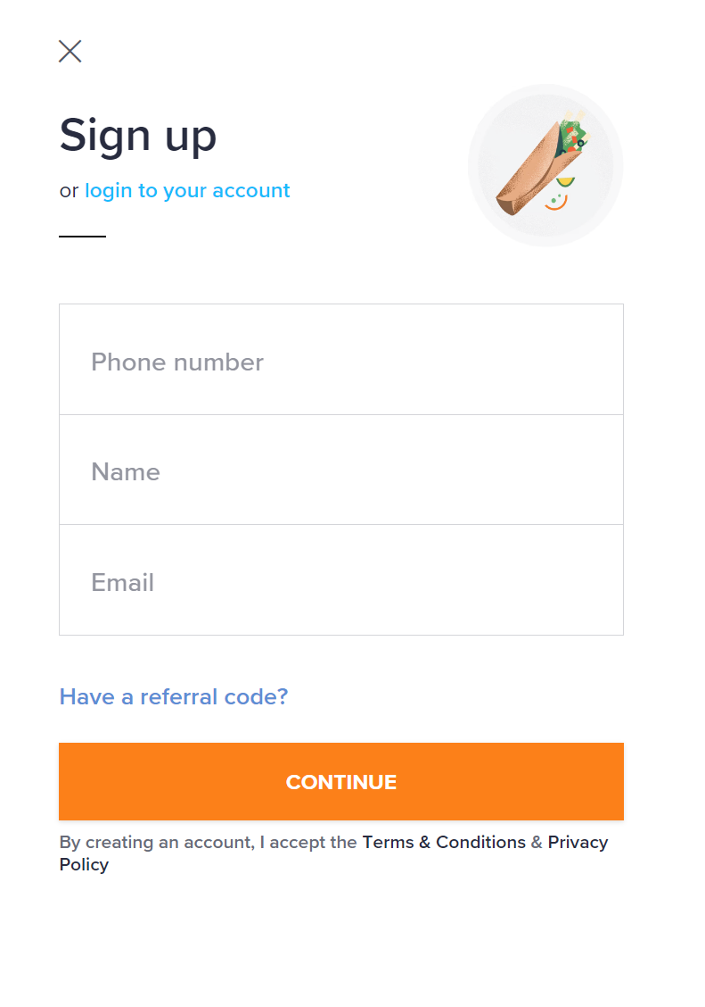
Sign Up Page:

Slide 4
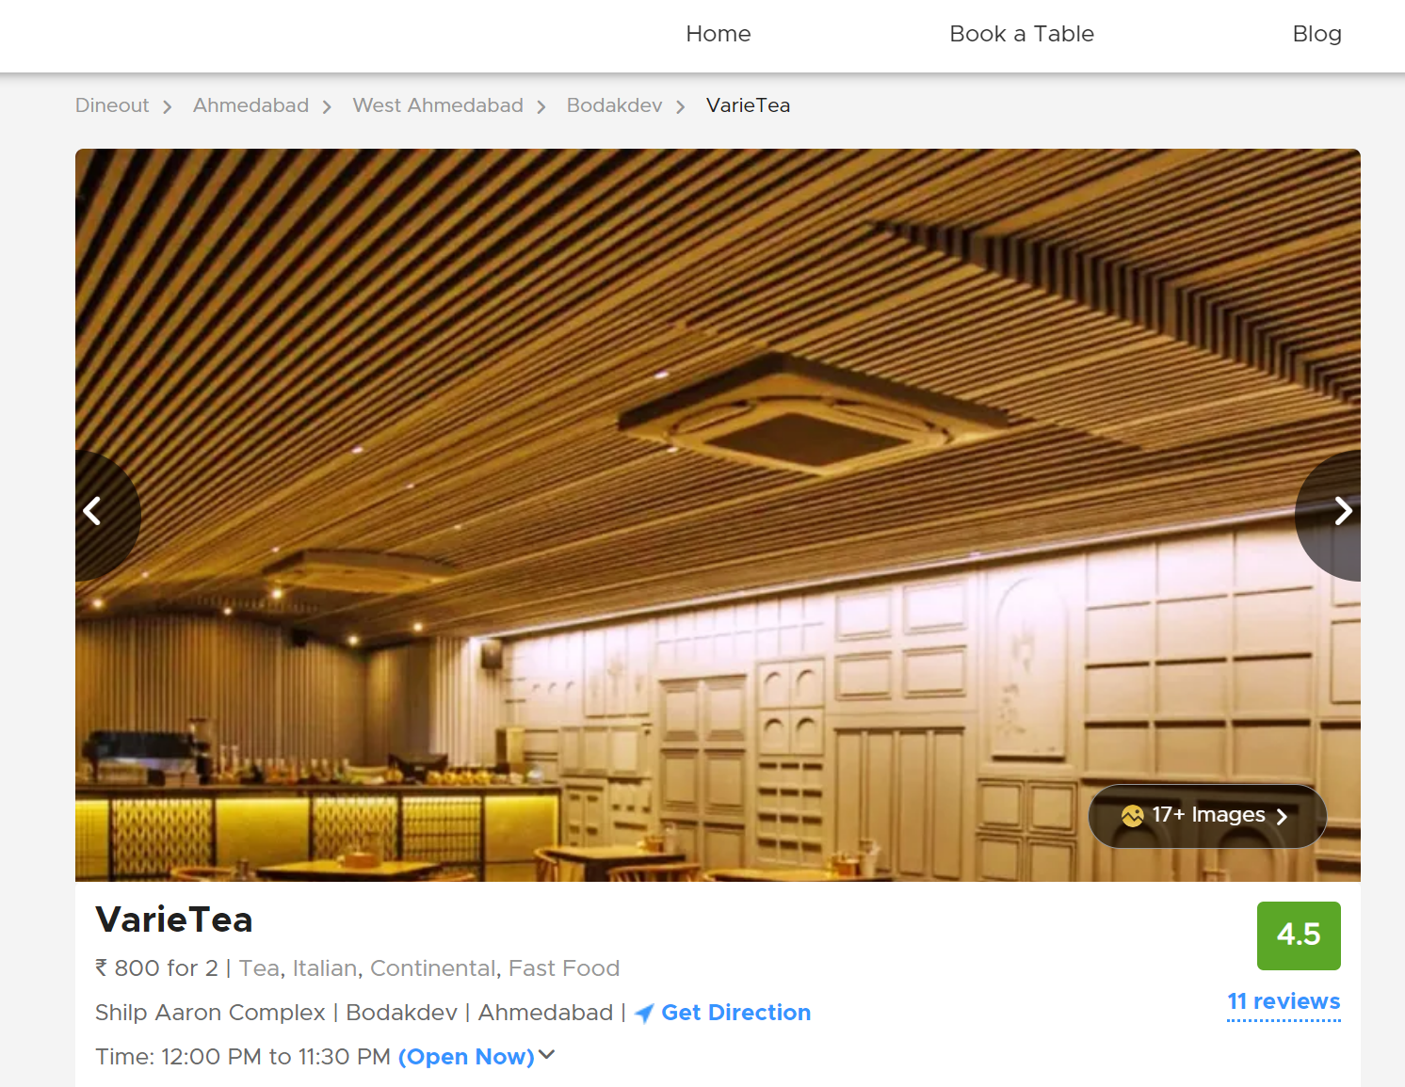
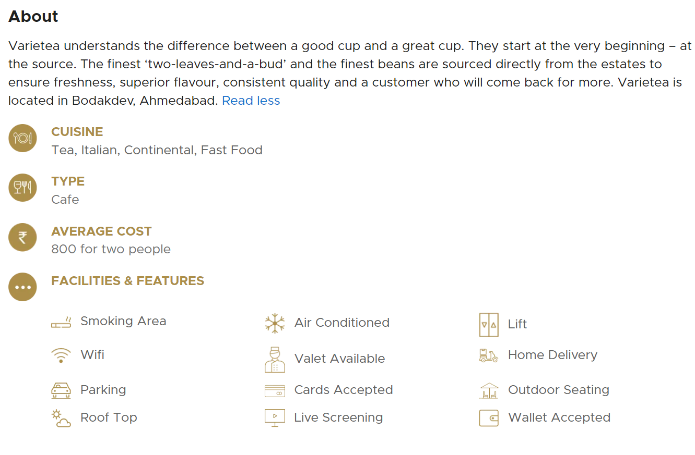
Table Booking Page:

Slide 5
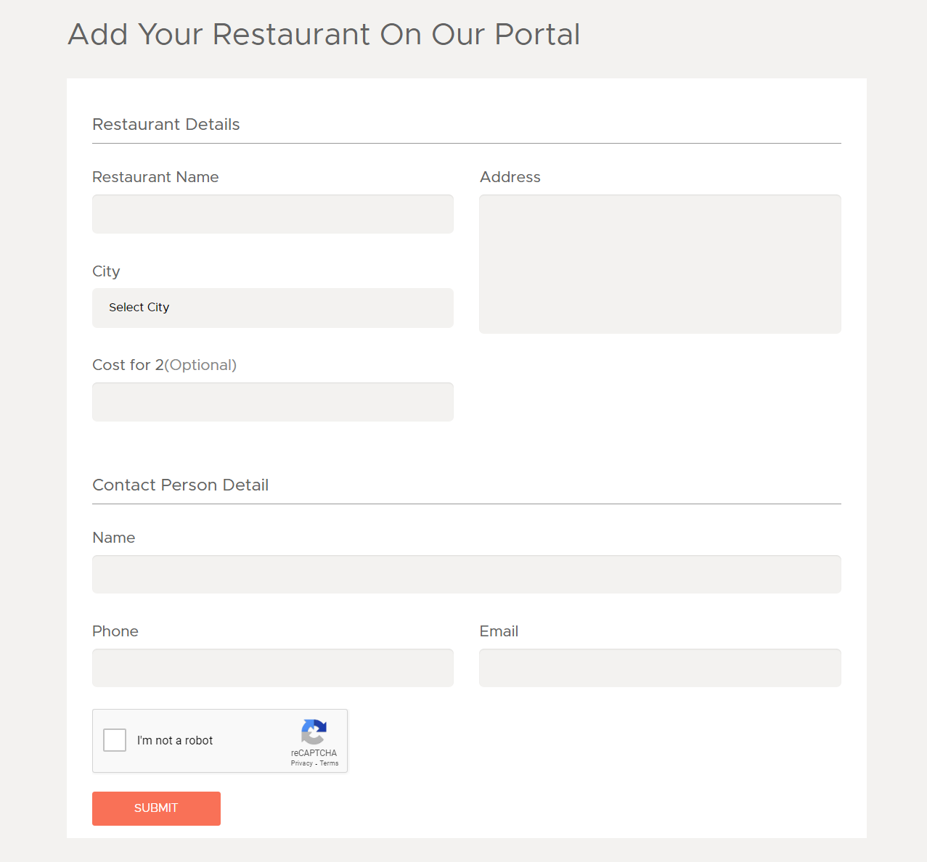
Add Restaurant Page:

Slide 6
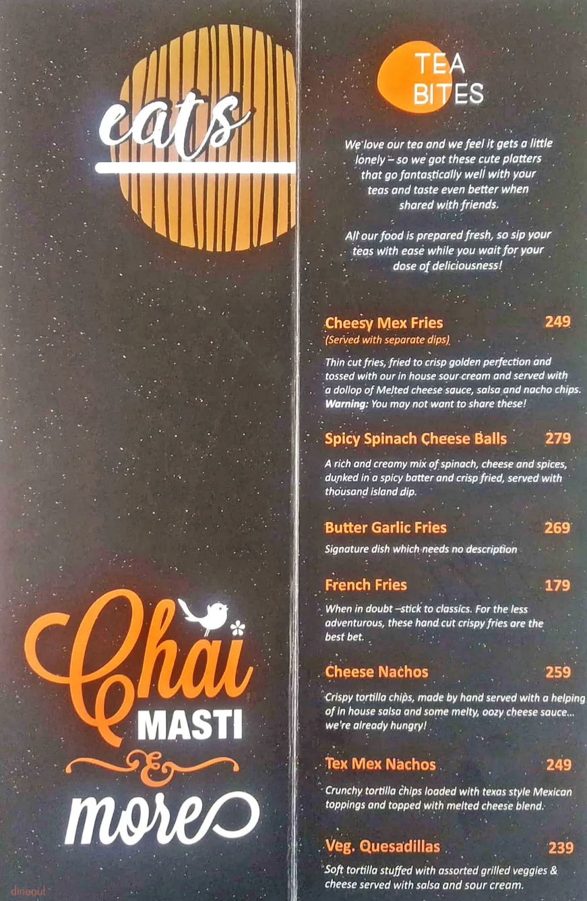
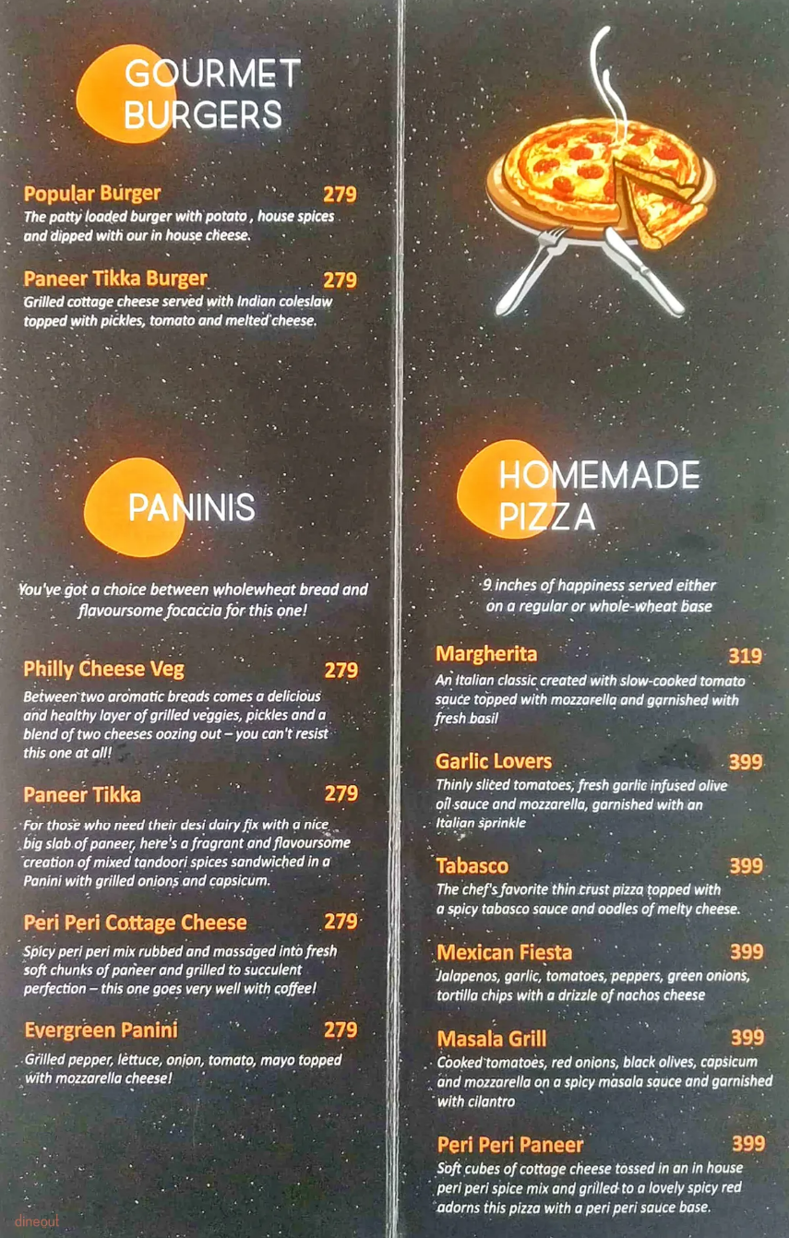
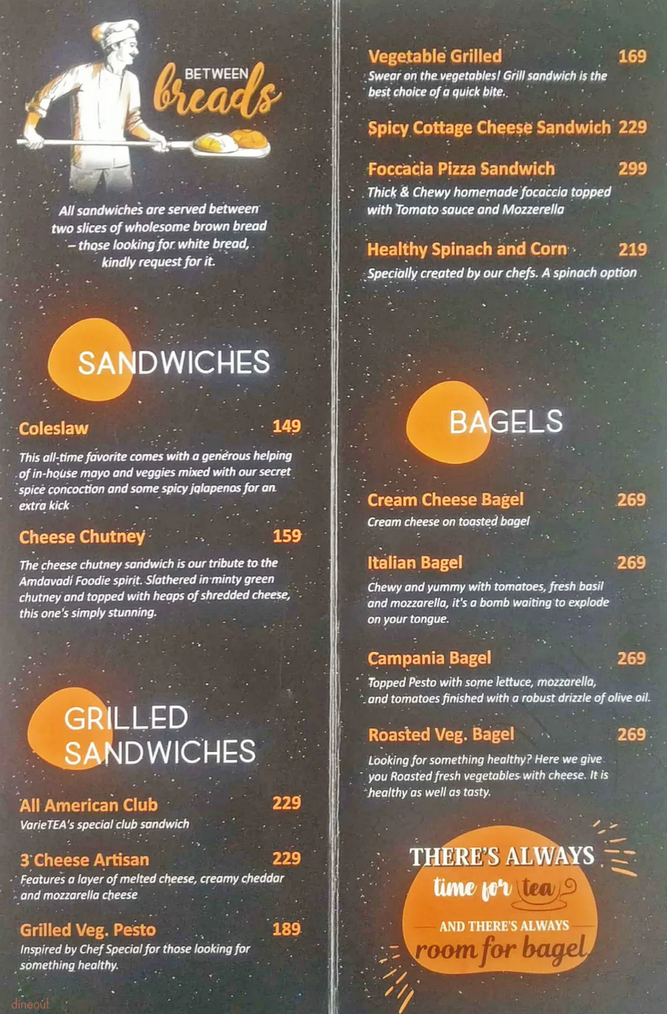
Menu Page:

Slide 7
THANK YOU !!!

